Slide 1
ECC Panther Sports Shooting

Slide 2
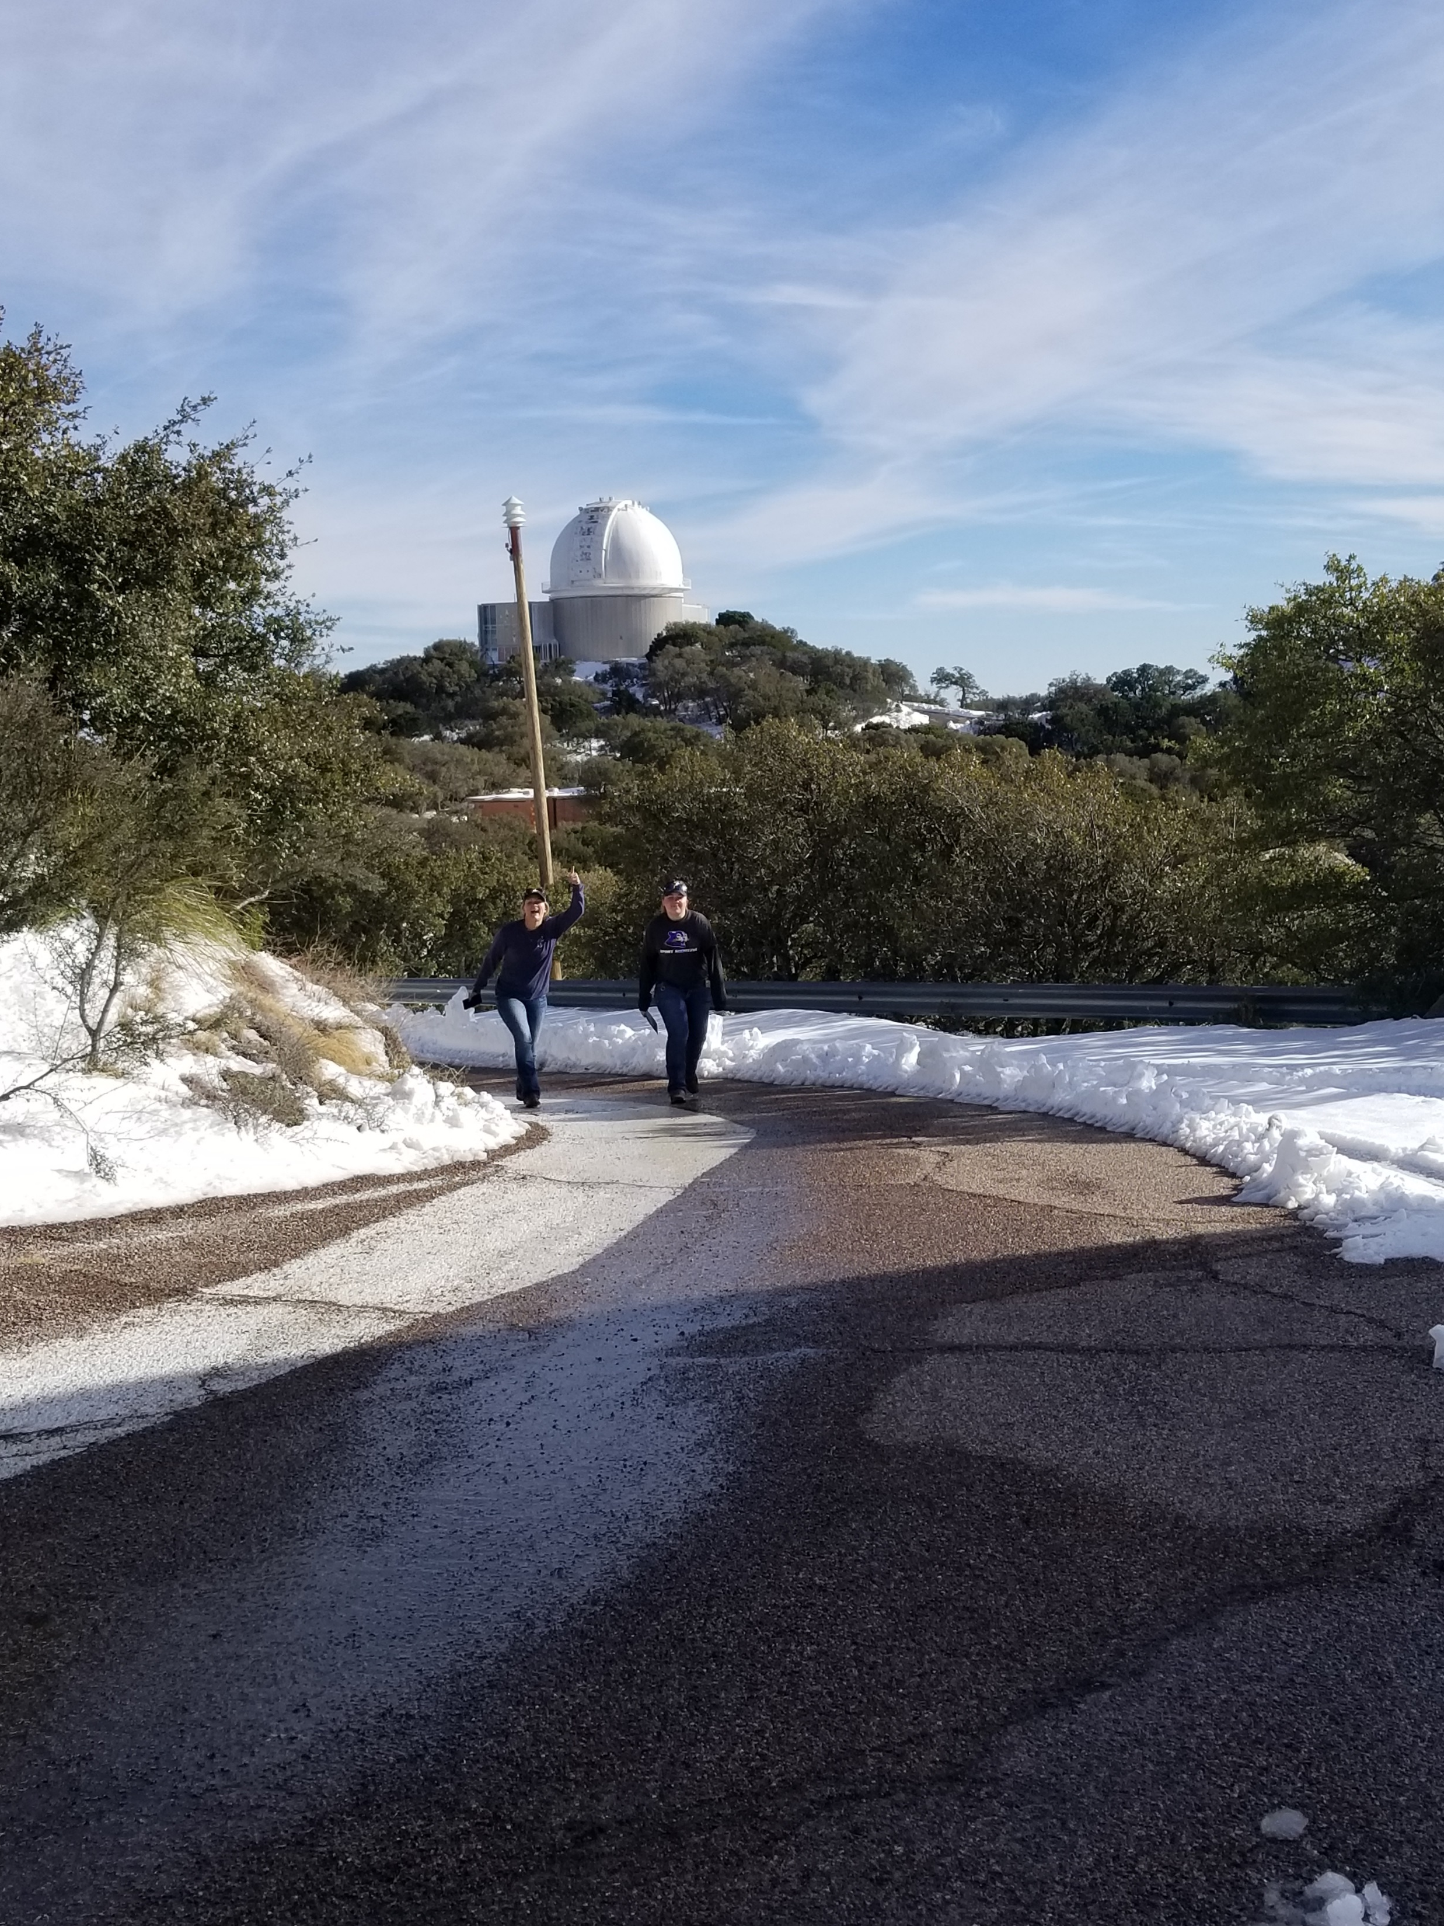
ECC Panther Sports Shooting
Travel to meets. When not shooting we explore.
Kitt Peak National Observatory
Between events we travel Tucson AZ Spring Nationals

Slide 3
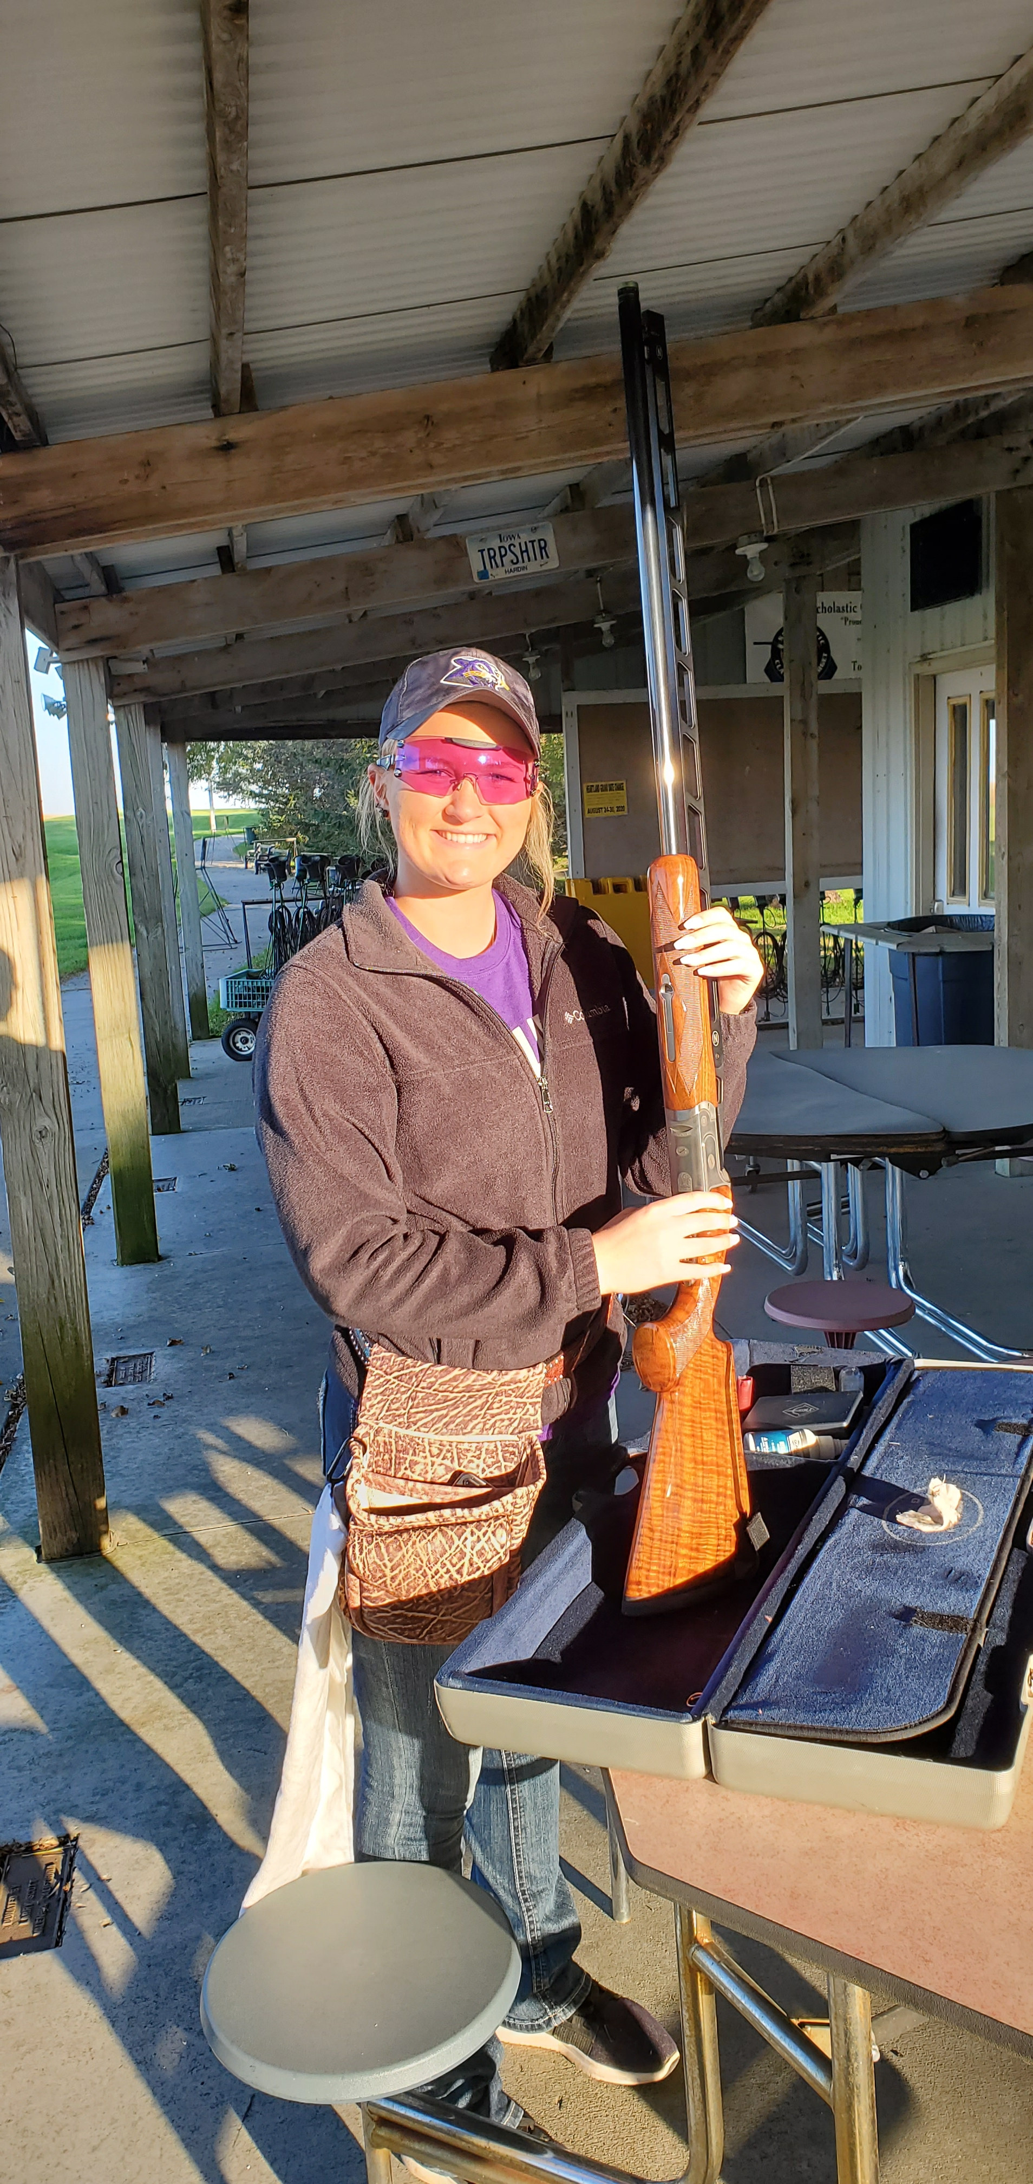
ECC Panther Sports Shooting

Slide 4
ECC Panther Sports Shooting

Slide 5
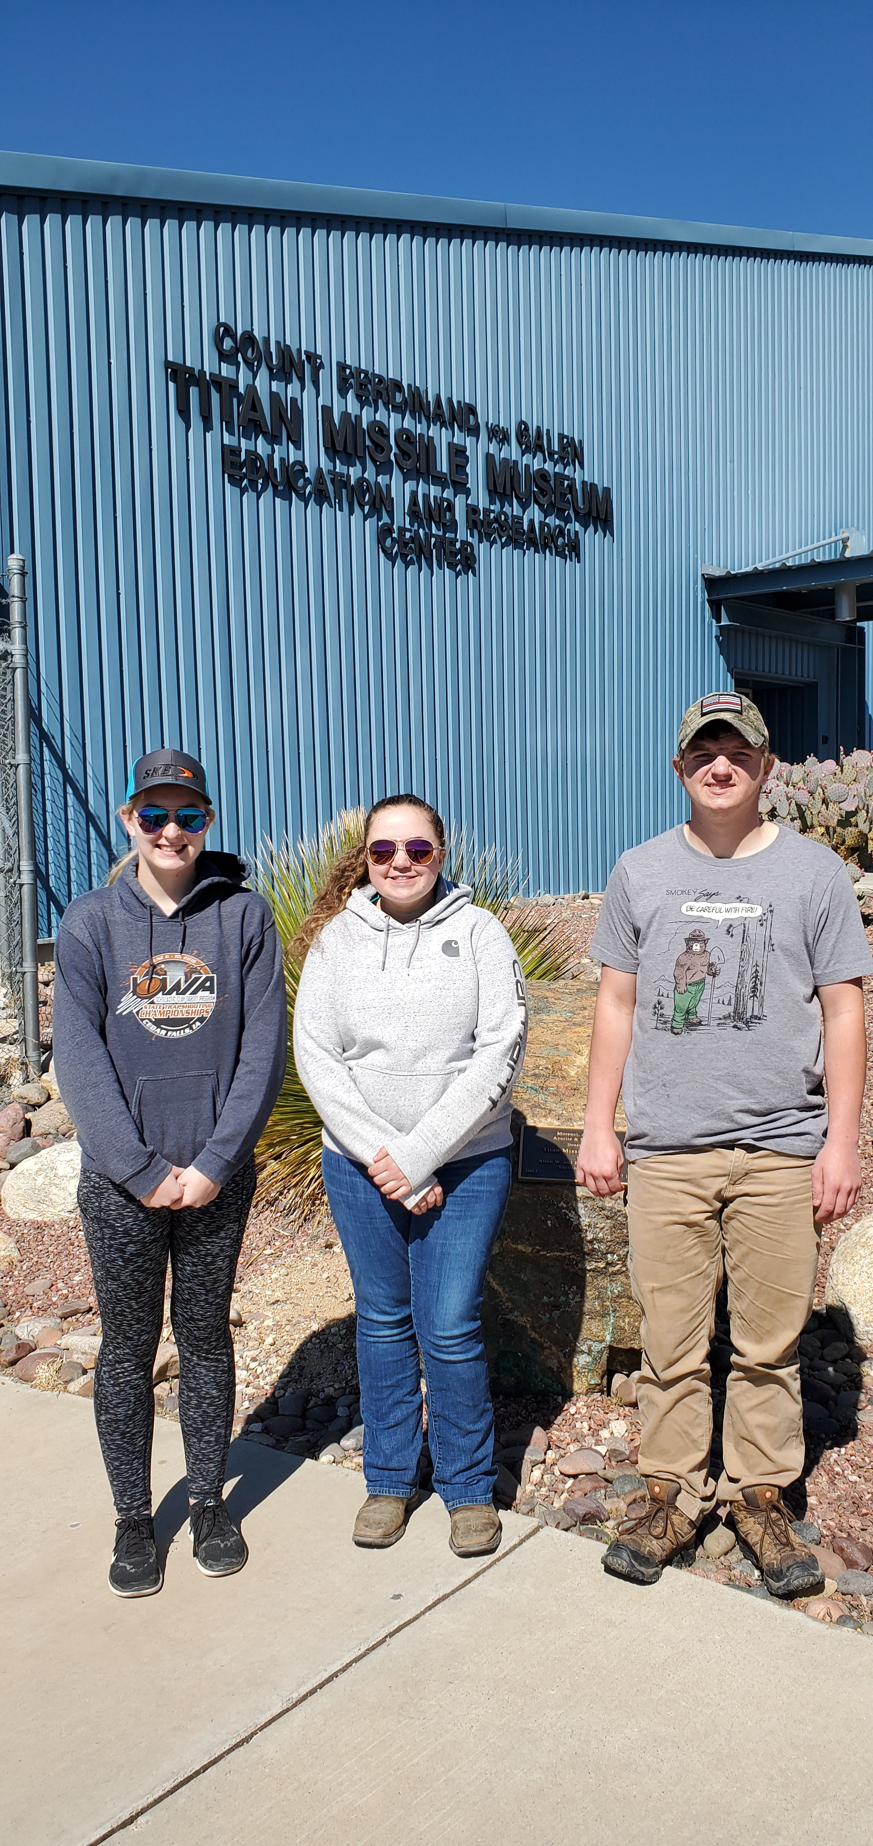
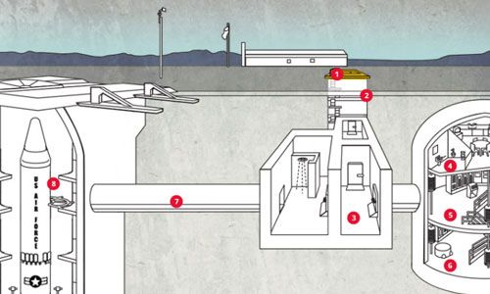
ECC Panther Sports Shooting
Between events we travel Tucson AZ Spring Nationals
Titan Missile Museum, Green Valley Arizona

Slide 6
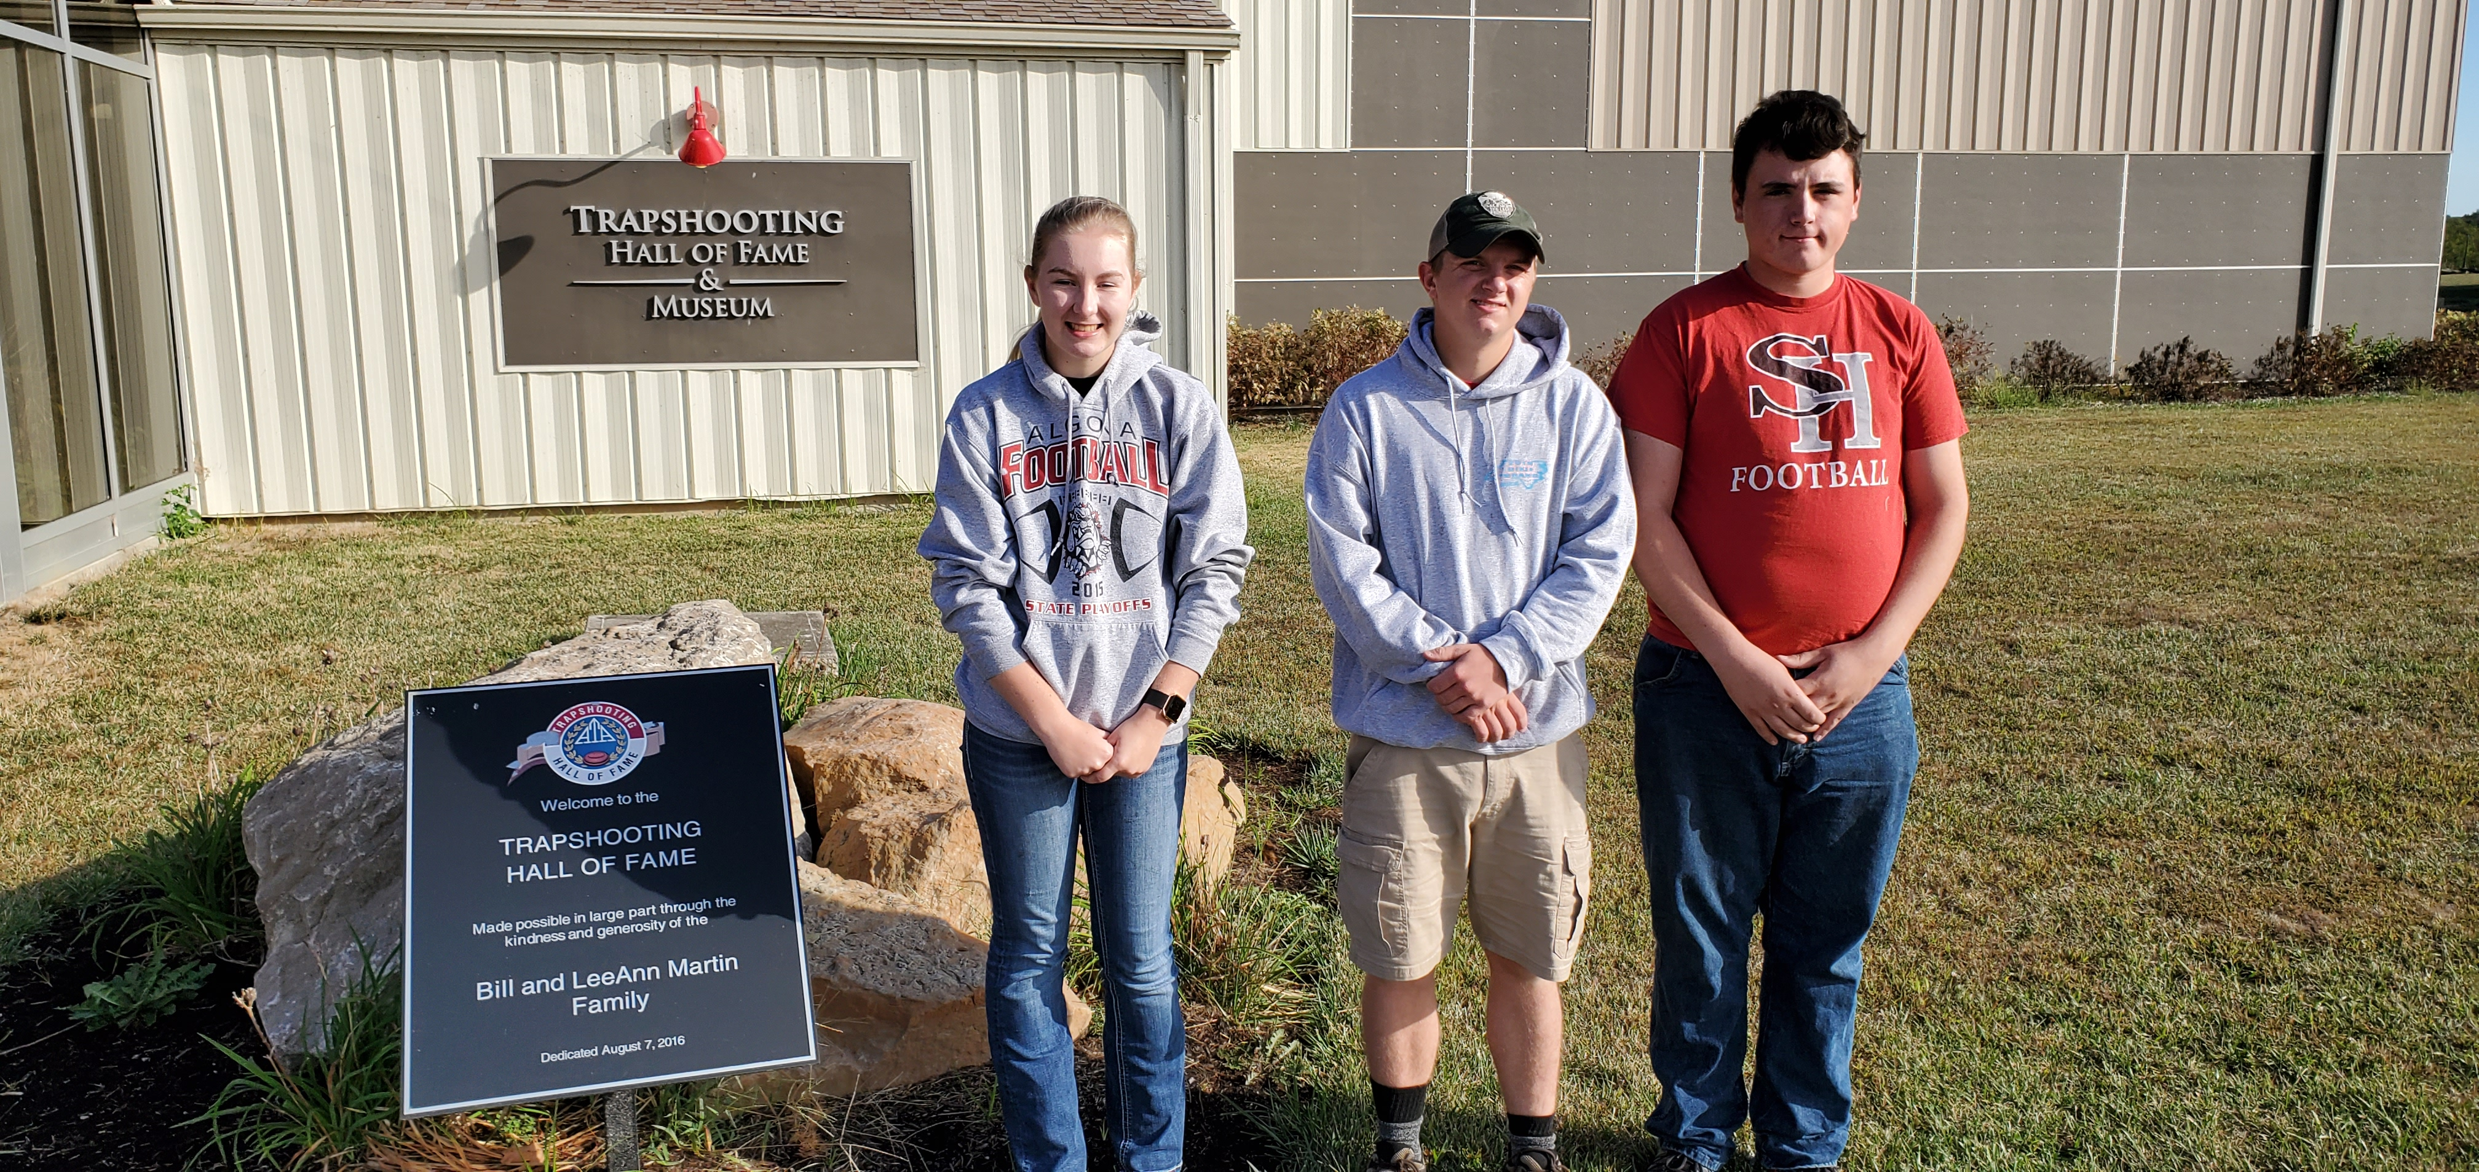
ECC Panther Sports Shooting
National trapshooting Hall of Fame Sparta Illinois

Slide 7
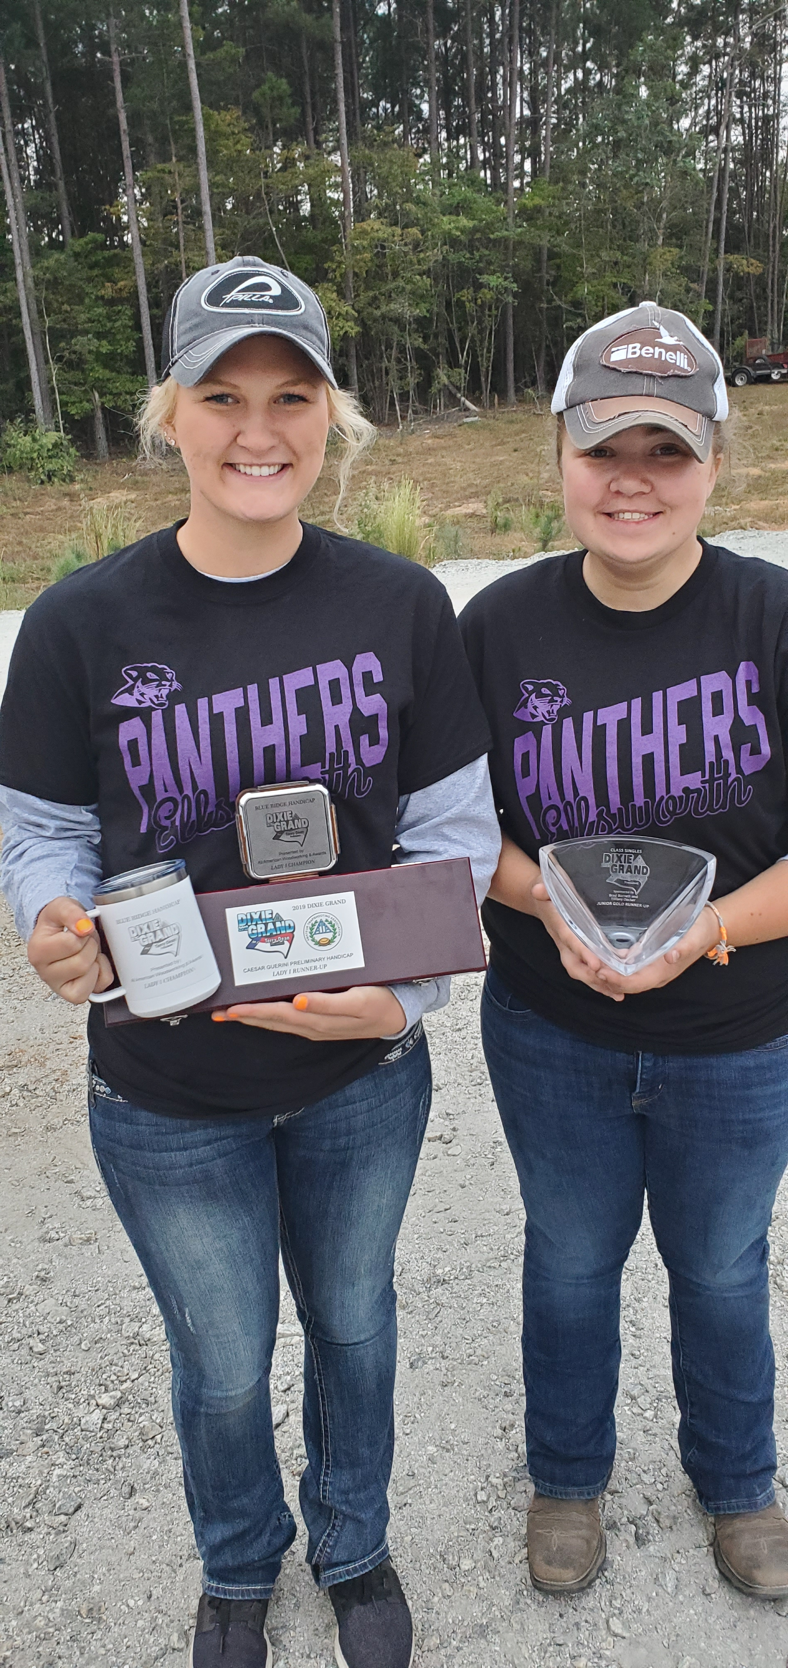
ECC Panther Sports Shooting
Panthers win more national titles at the Dixie Nationals, Bostik North Carolina

Slide 8
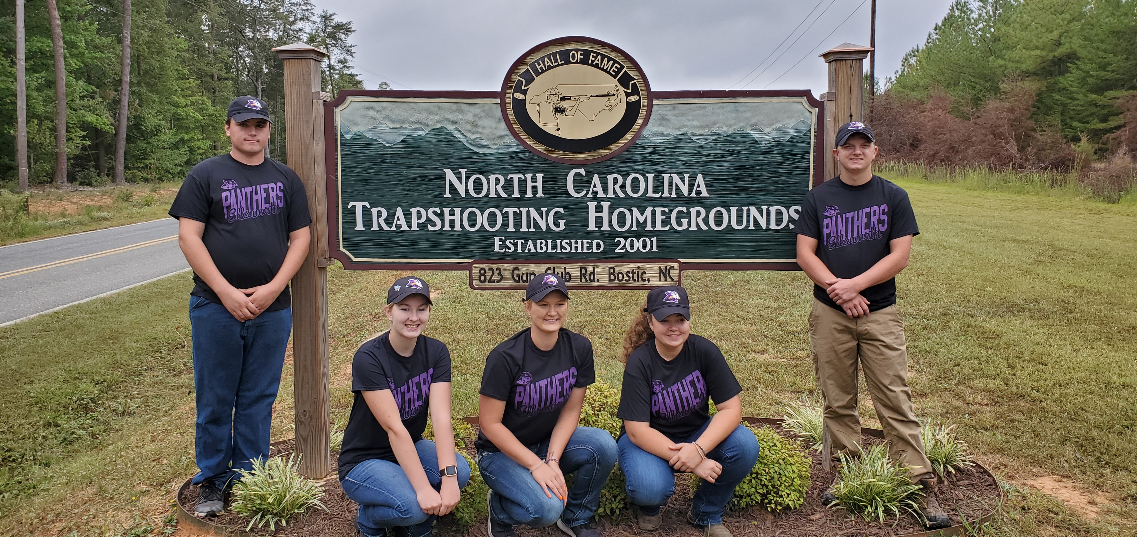
ECC Panther Sports Shooting
Dixie Grand National Trapshooting, Bostik North Carolina

Slide 9
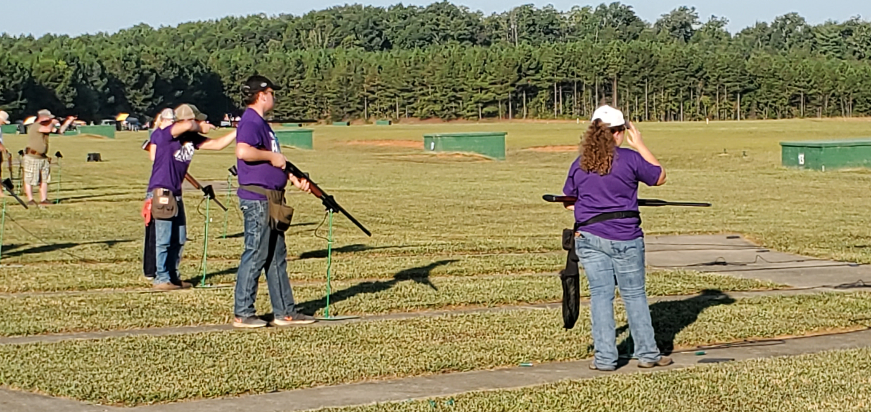
ECC Panther Sports Shooting
Dixie Grand National event, Bostick, North Carolina

Slide 10
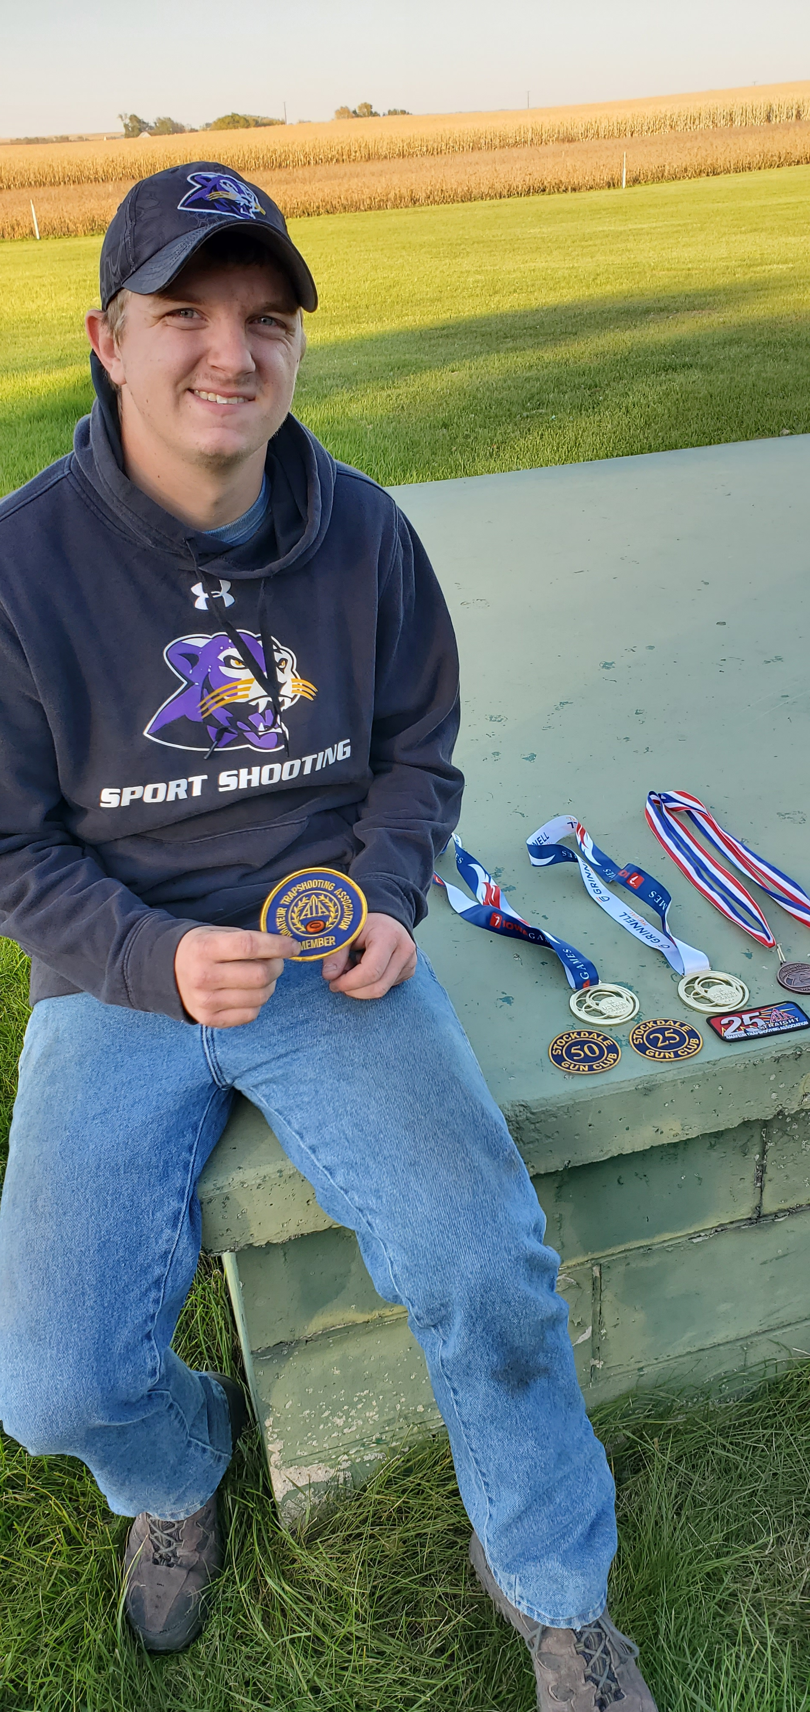
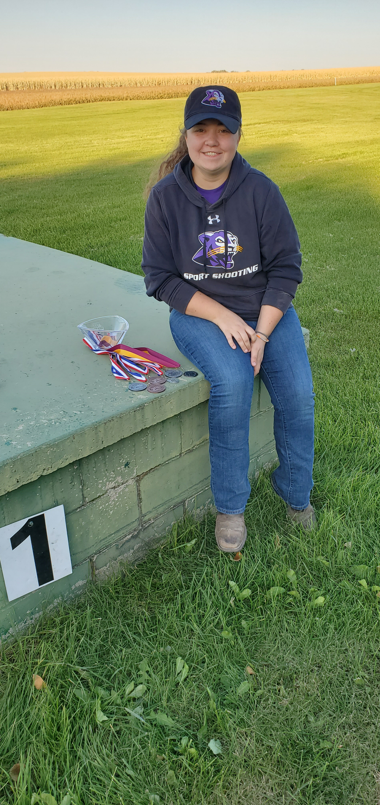
ECC Panther Sports Shooting
More wins

Slide 11
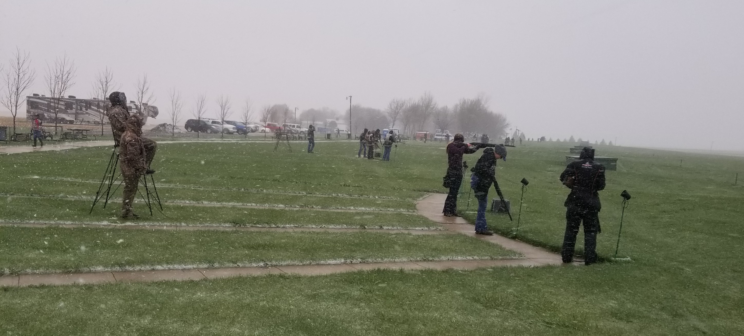
ECC Panther Sports Shooting
Ready for anything

Slide 12
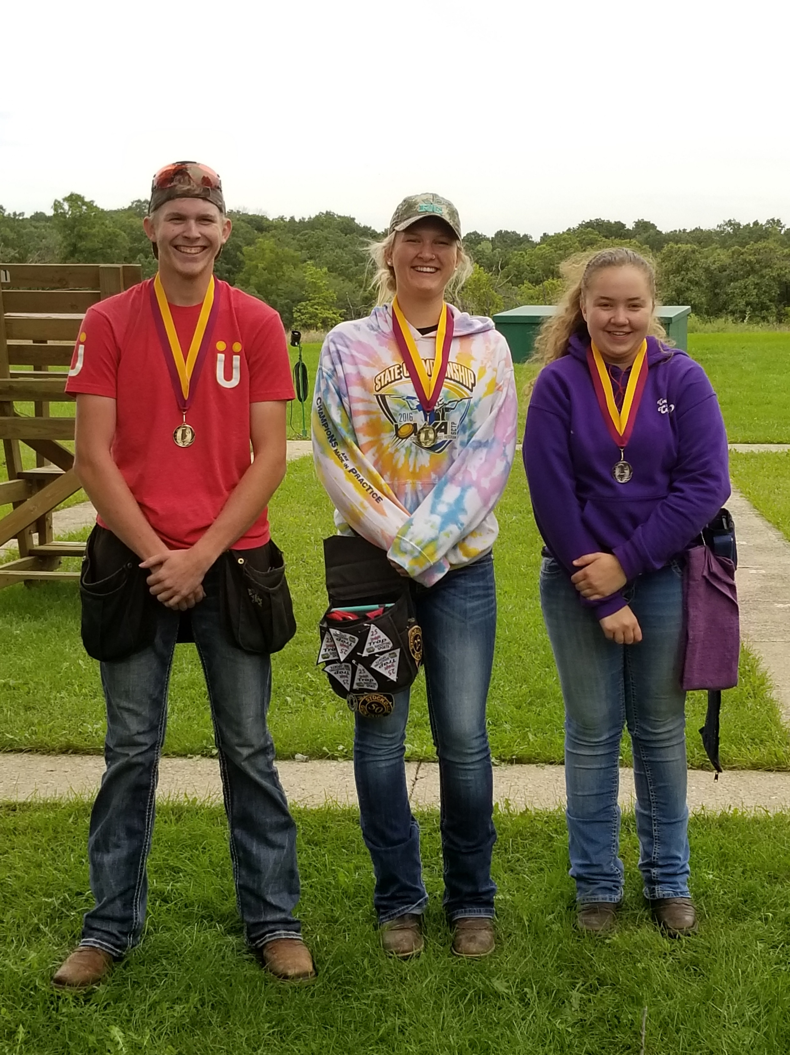
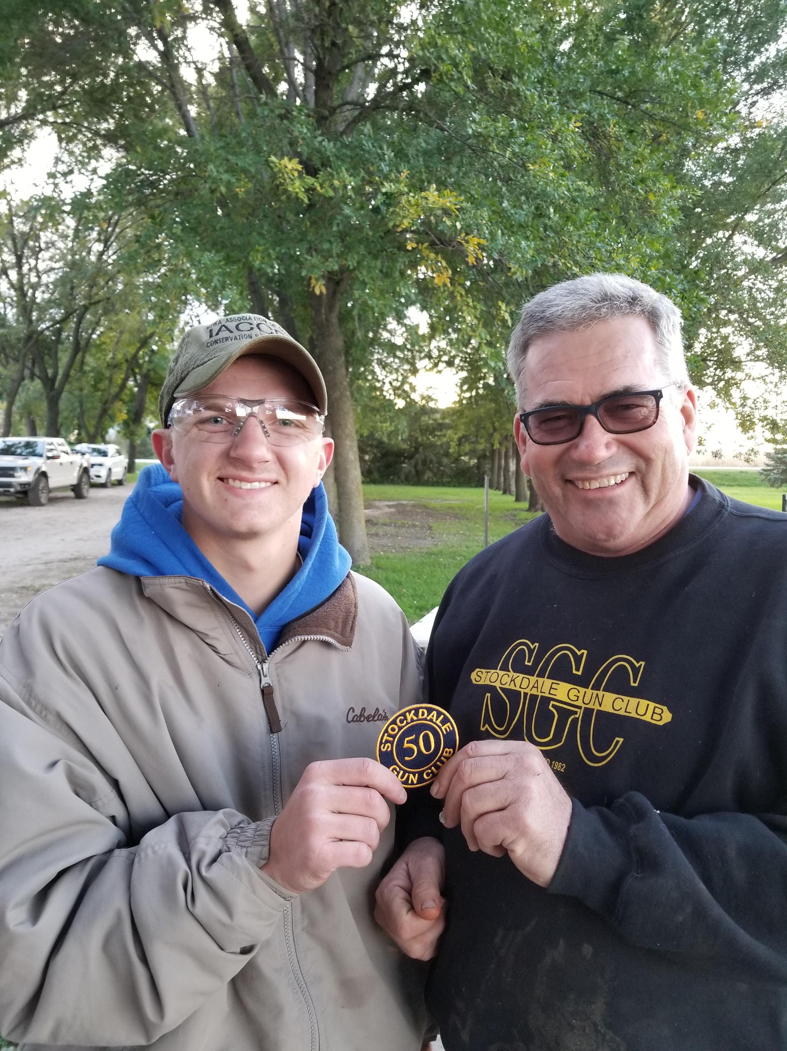
ECC Panther Sports Shooting
On the season

Slide 13
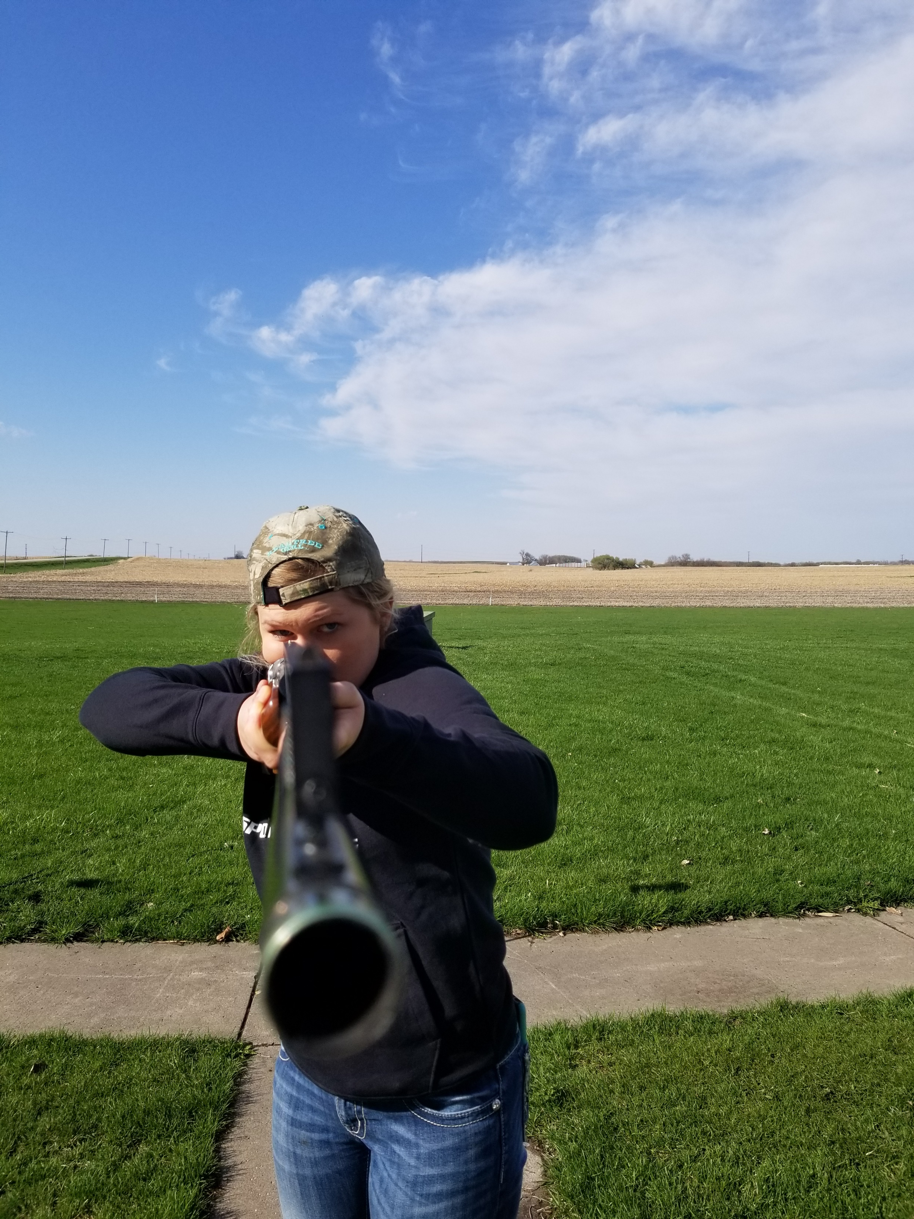
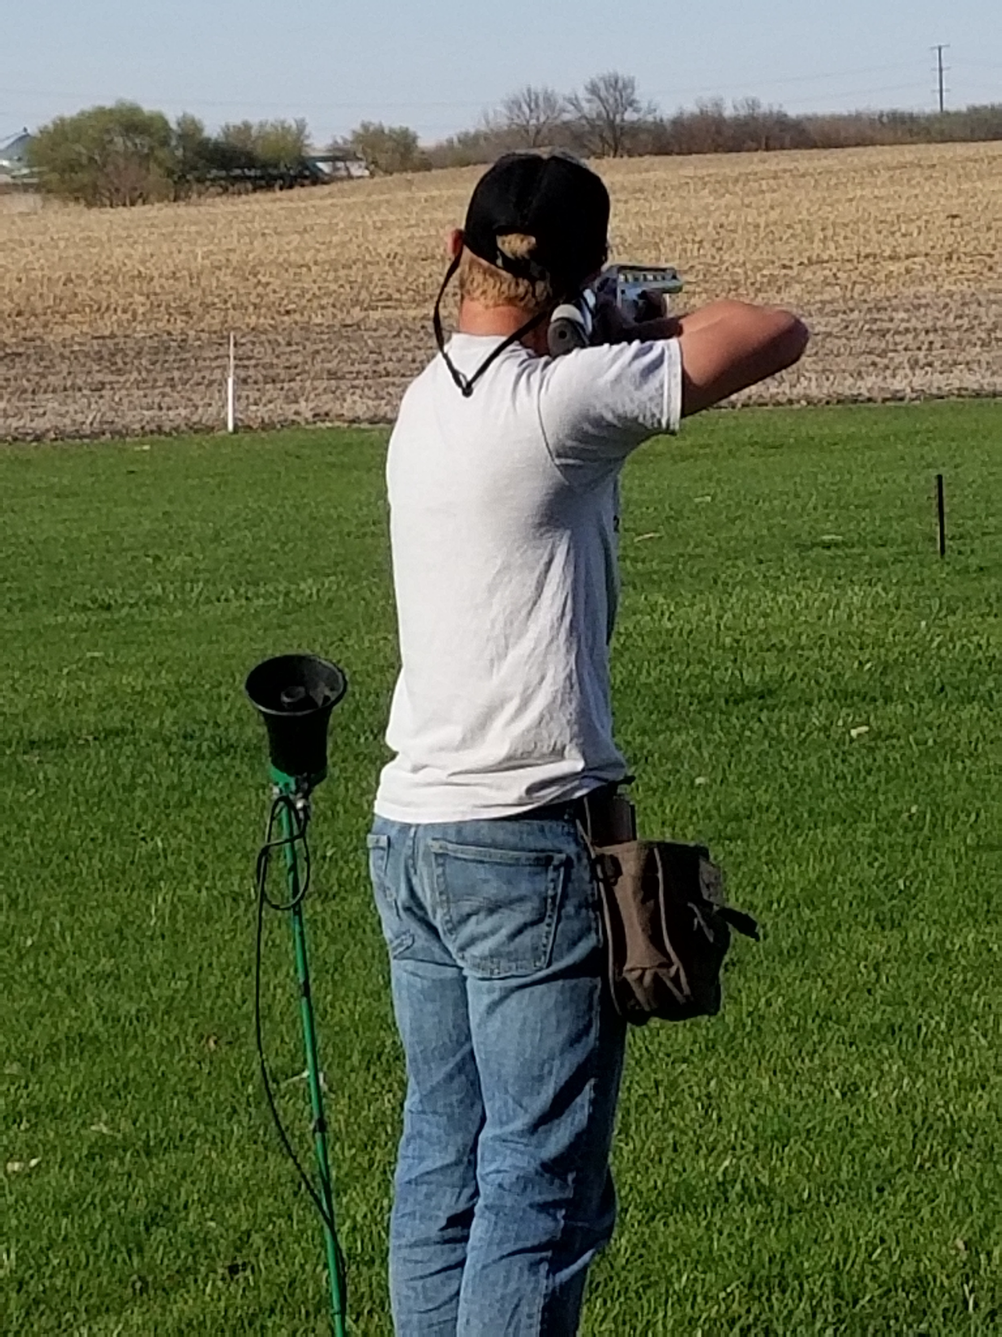
ECC Panther Sports Shooting
Look Point Shoot

Slide 14
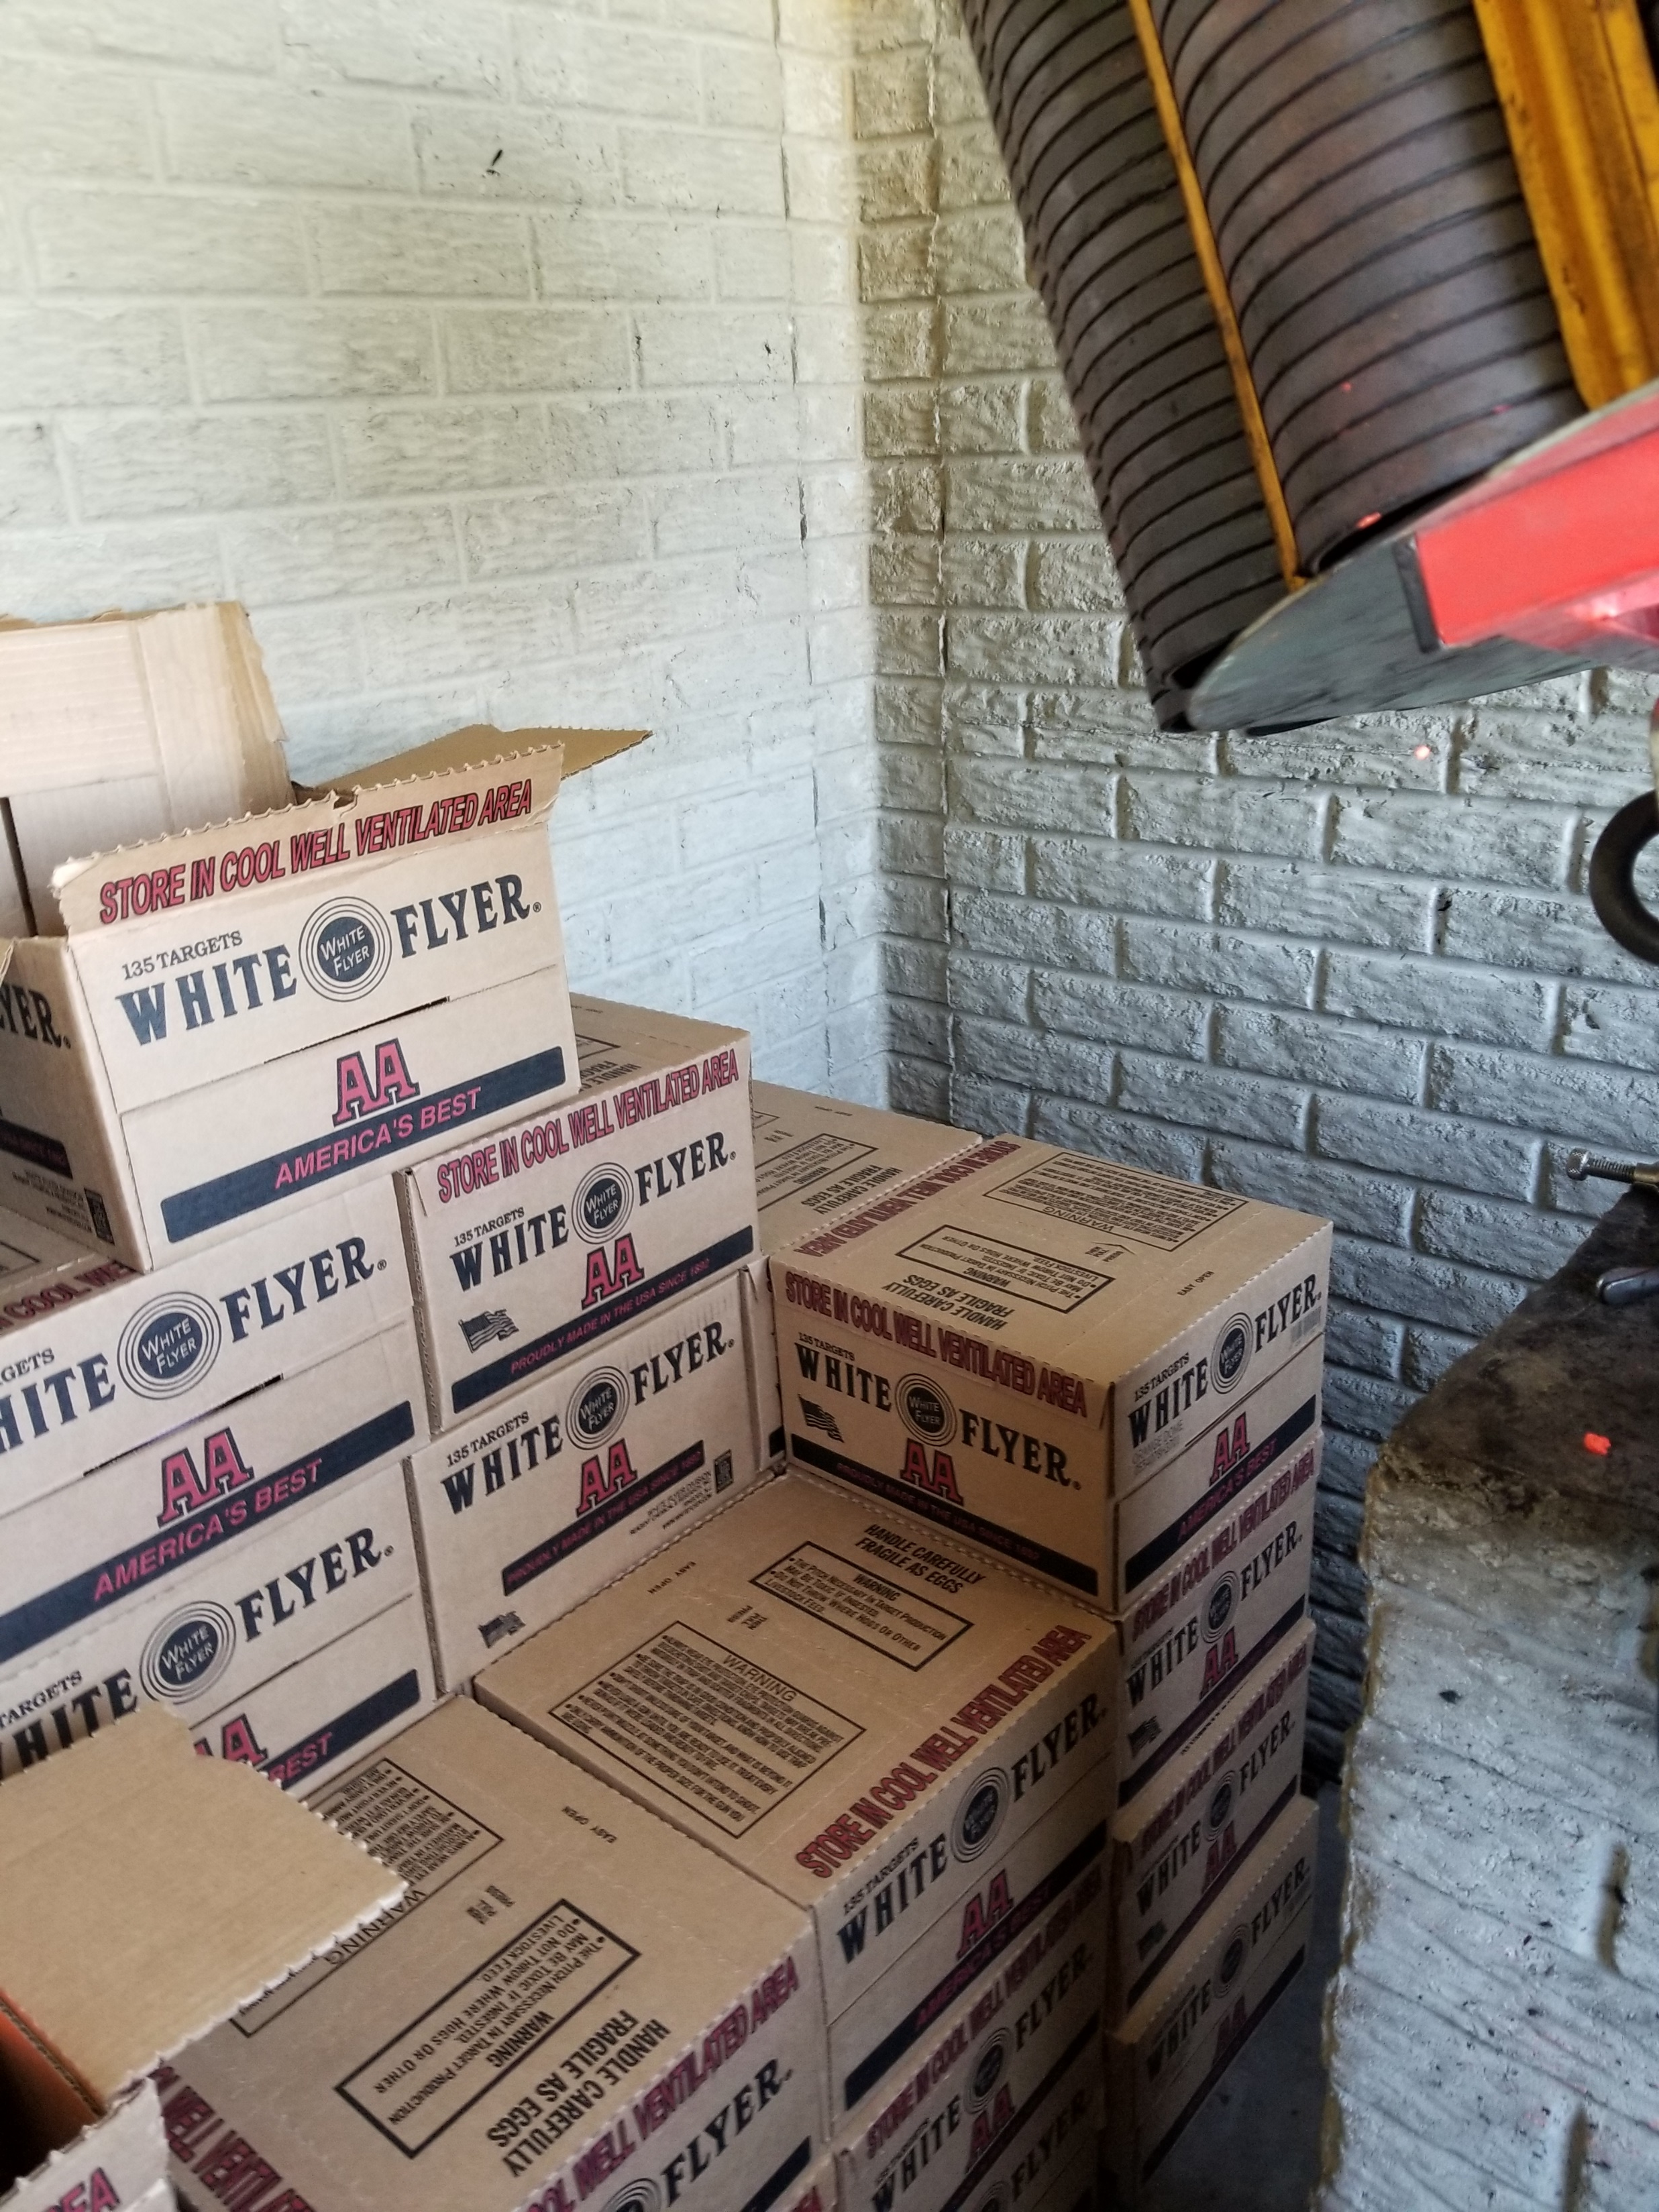
ECC Panther Sports Shooting

Slide 15
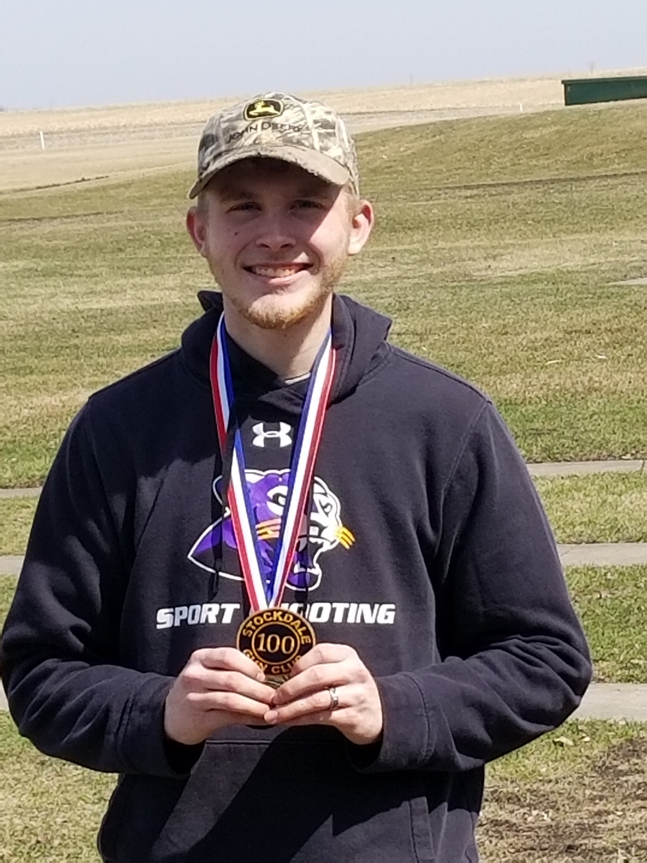
ECC Panther Sports Shooting
100 x 100

Slide 16
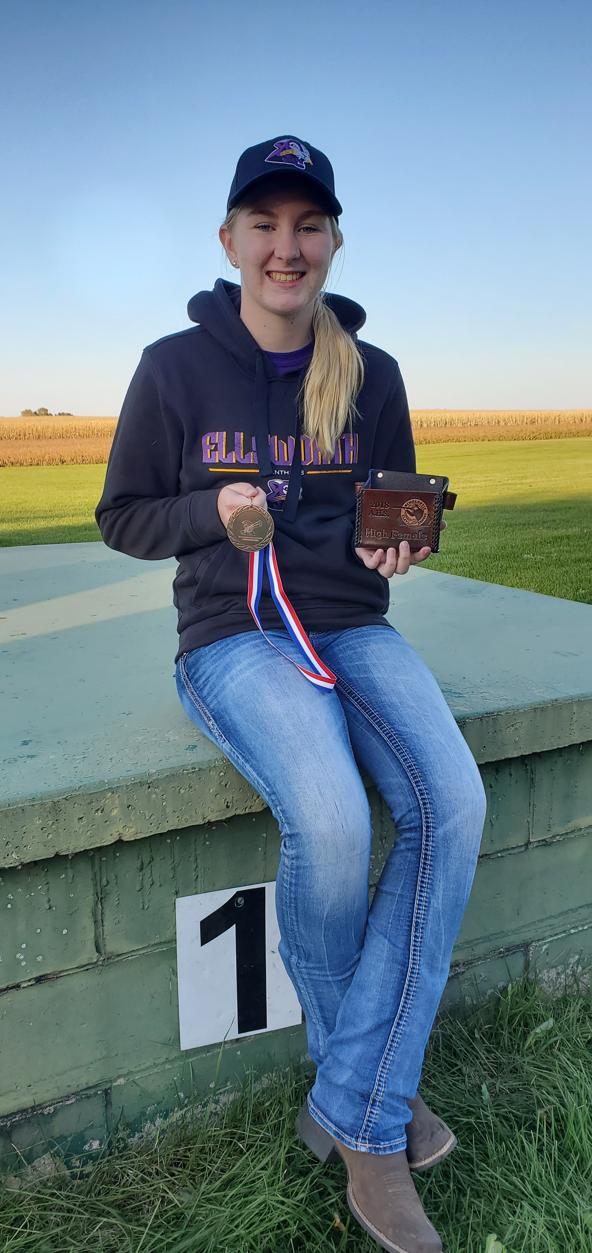
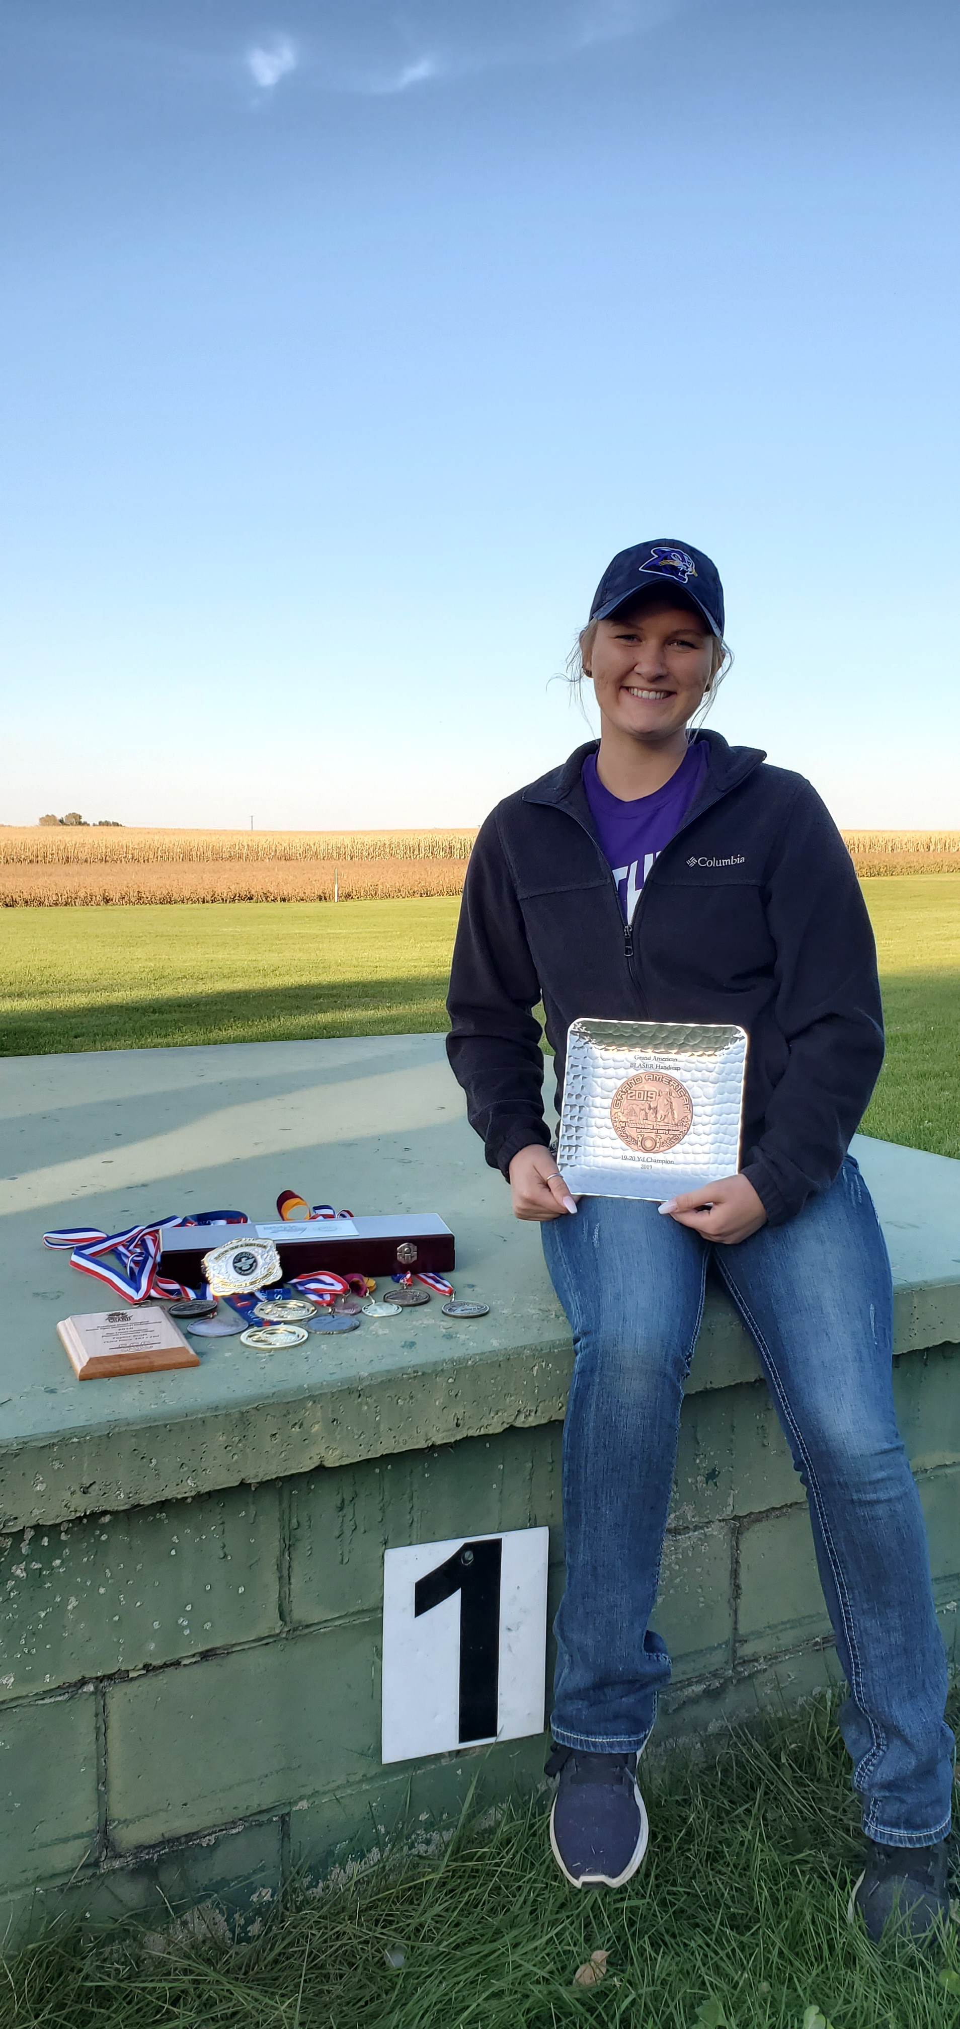
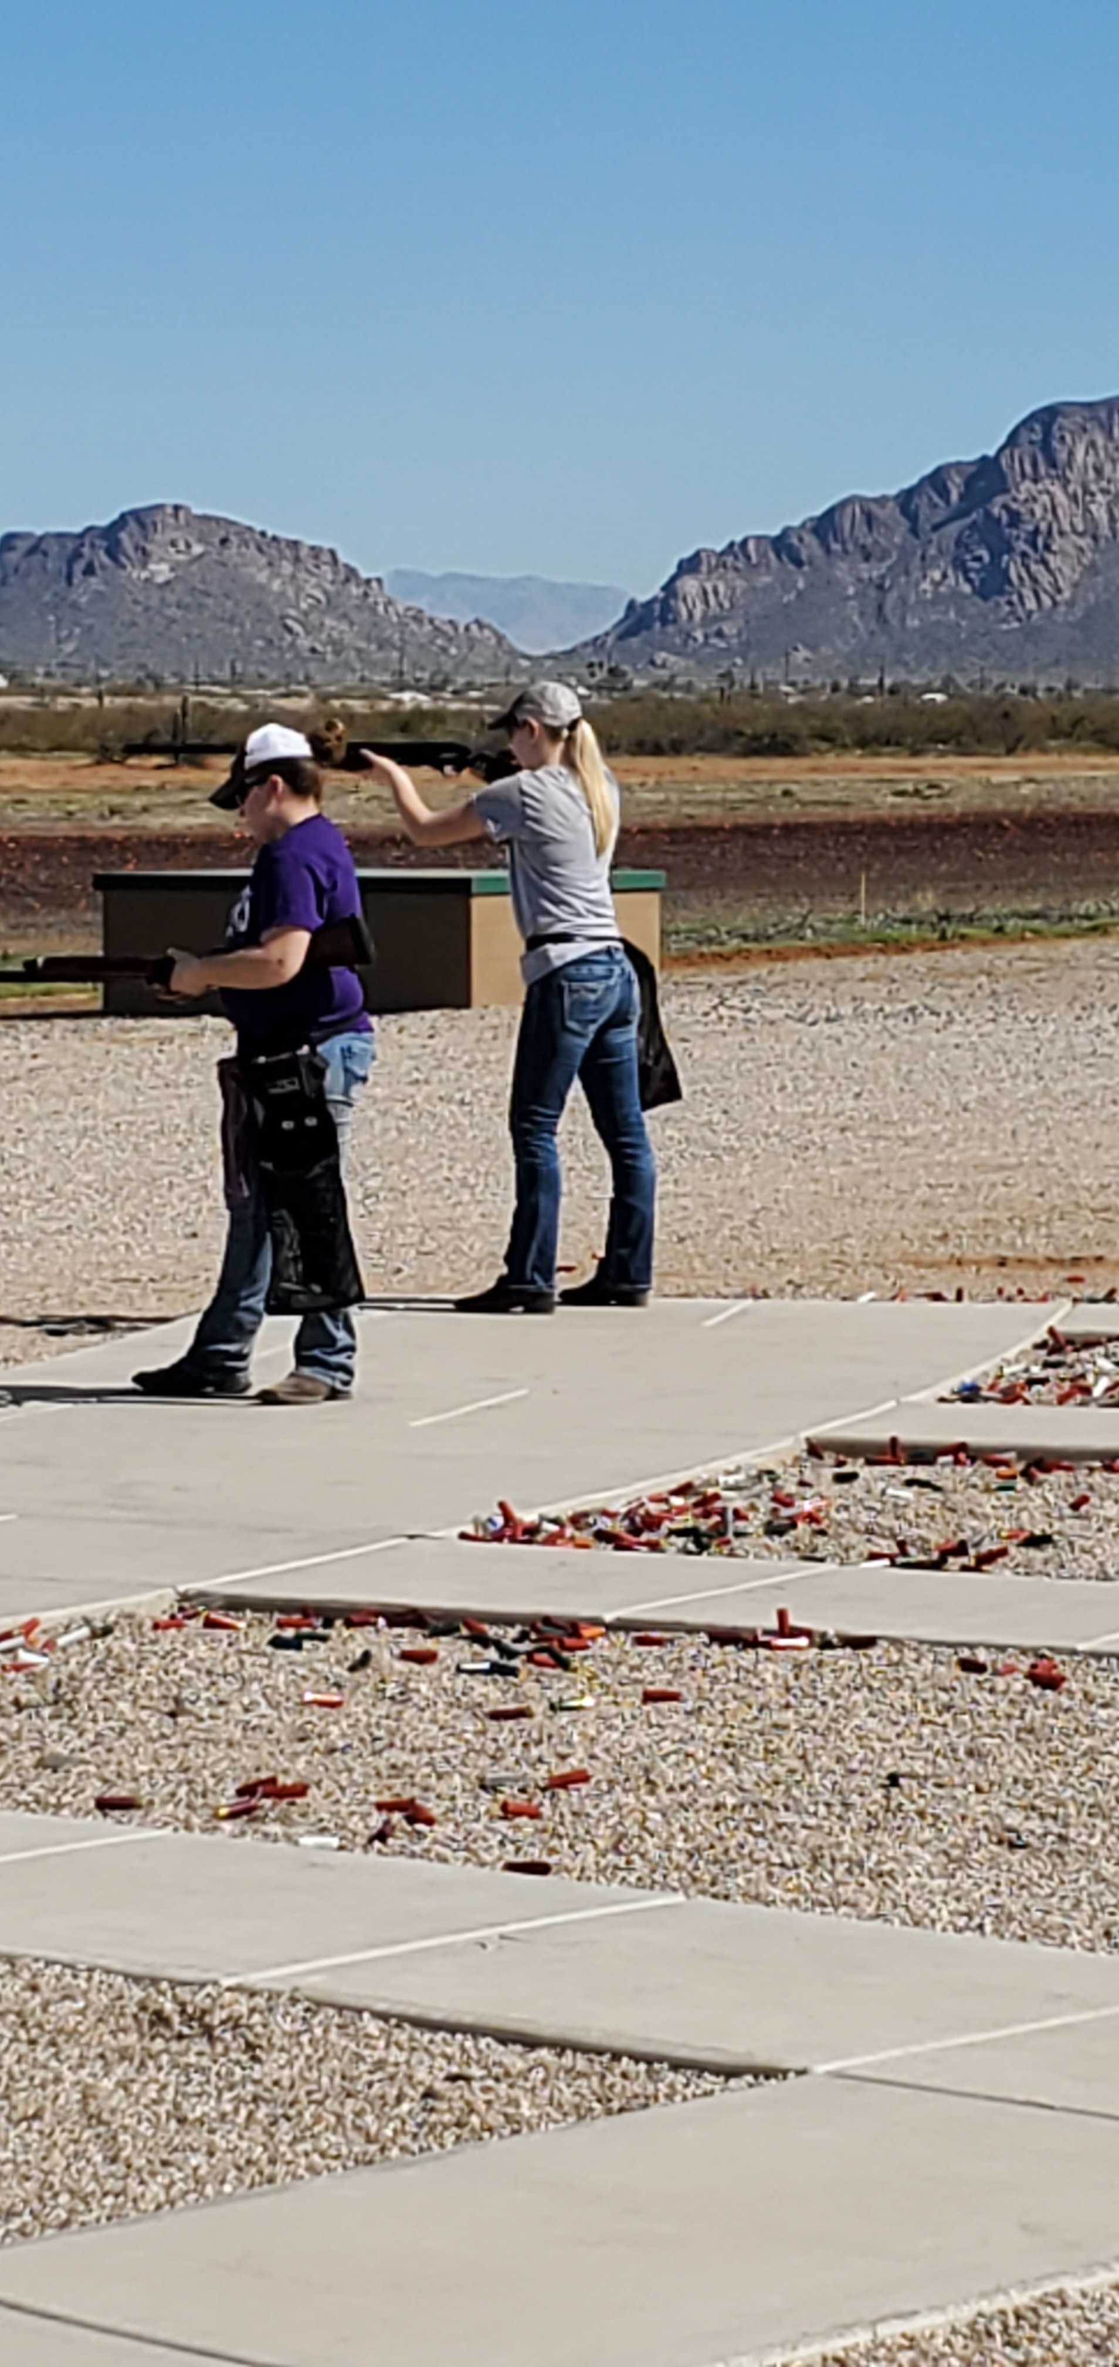
ECC Panther Sports Shooting
Winning

Slide 17
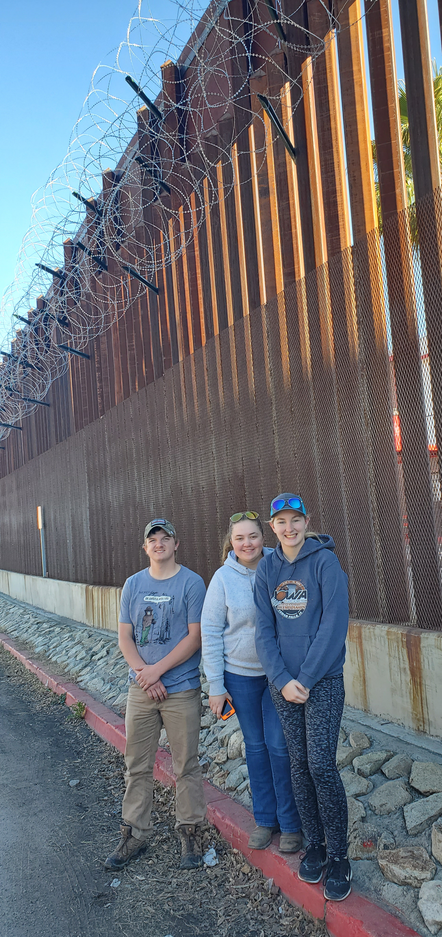
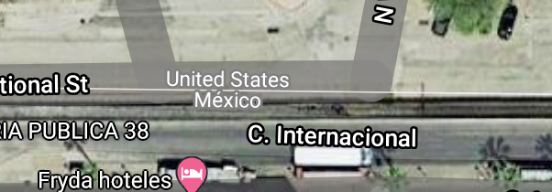
ECC Panther Sports Shooting
Mexico United State Boarder
Between events we like to explore
Spring National Trapshooting Event Tucson AZ
W International ST Nogales AZ at the beginning of Interstate I-19

Slide 18
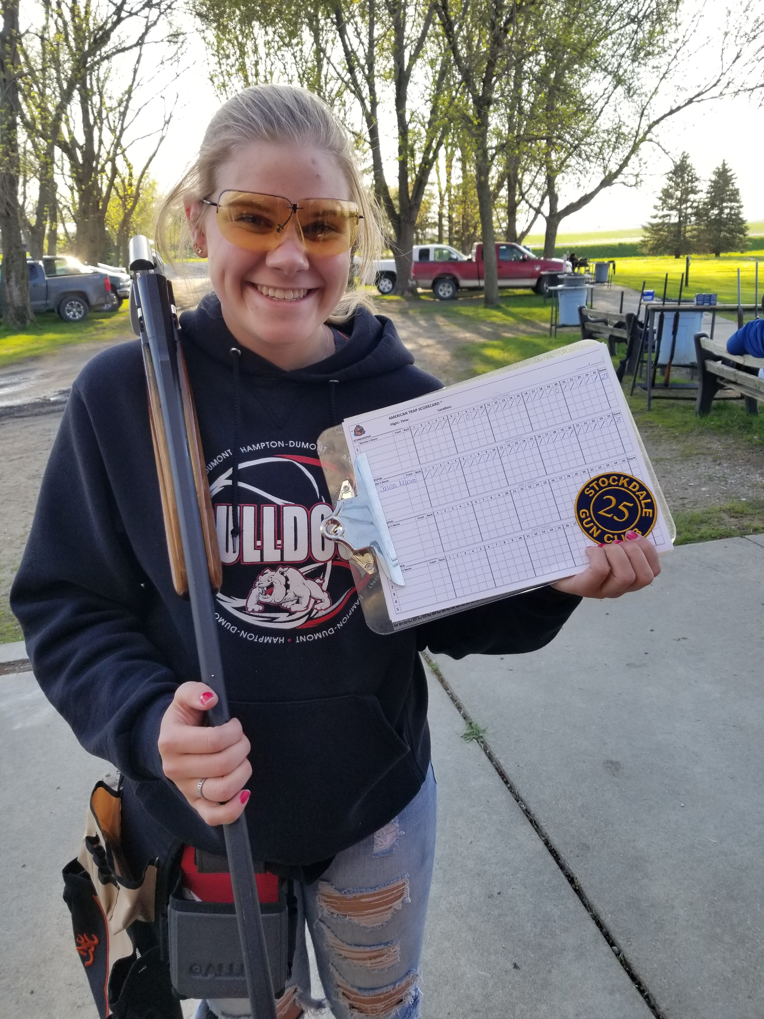
ECC Panther Sports Shooting

Slide 19
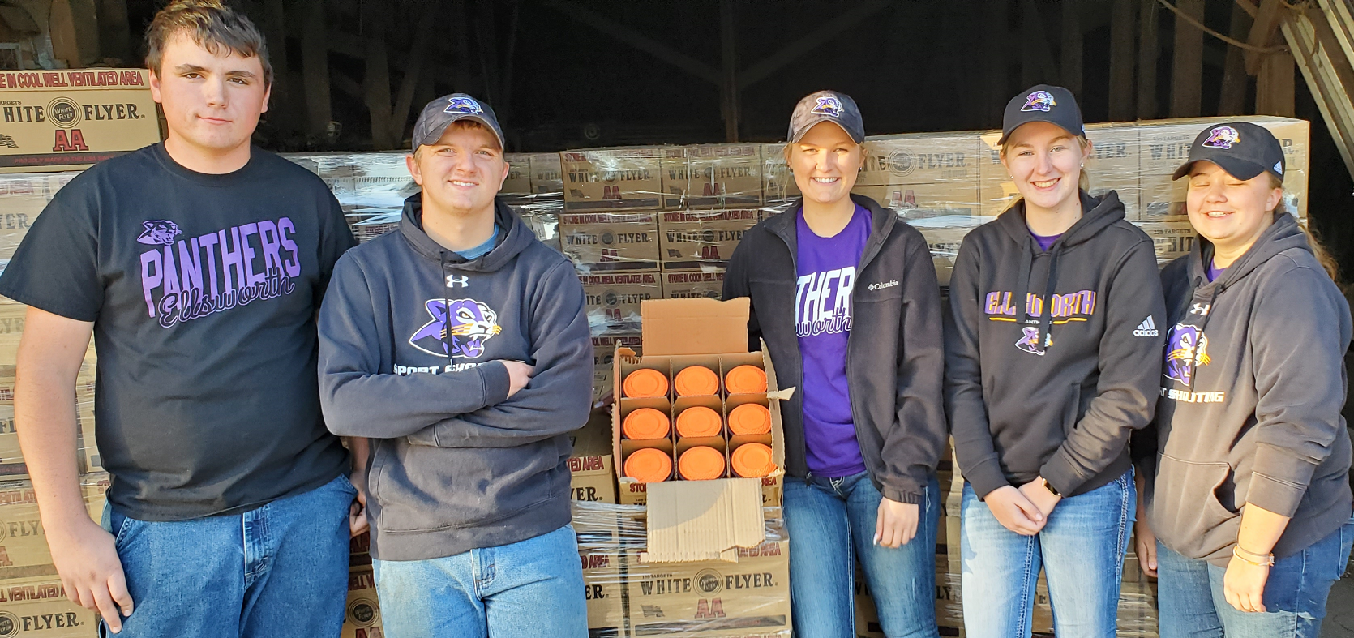
ECC Panther Sports Shooting

Slide 20
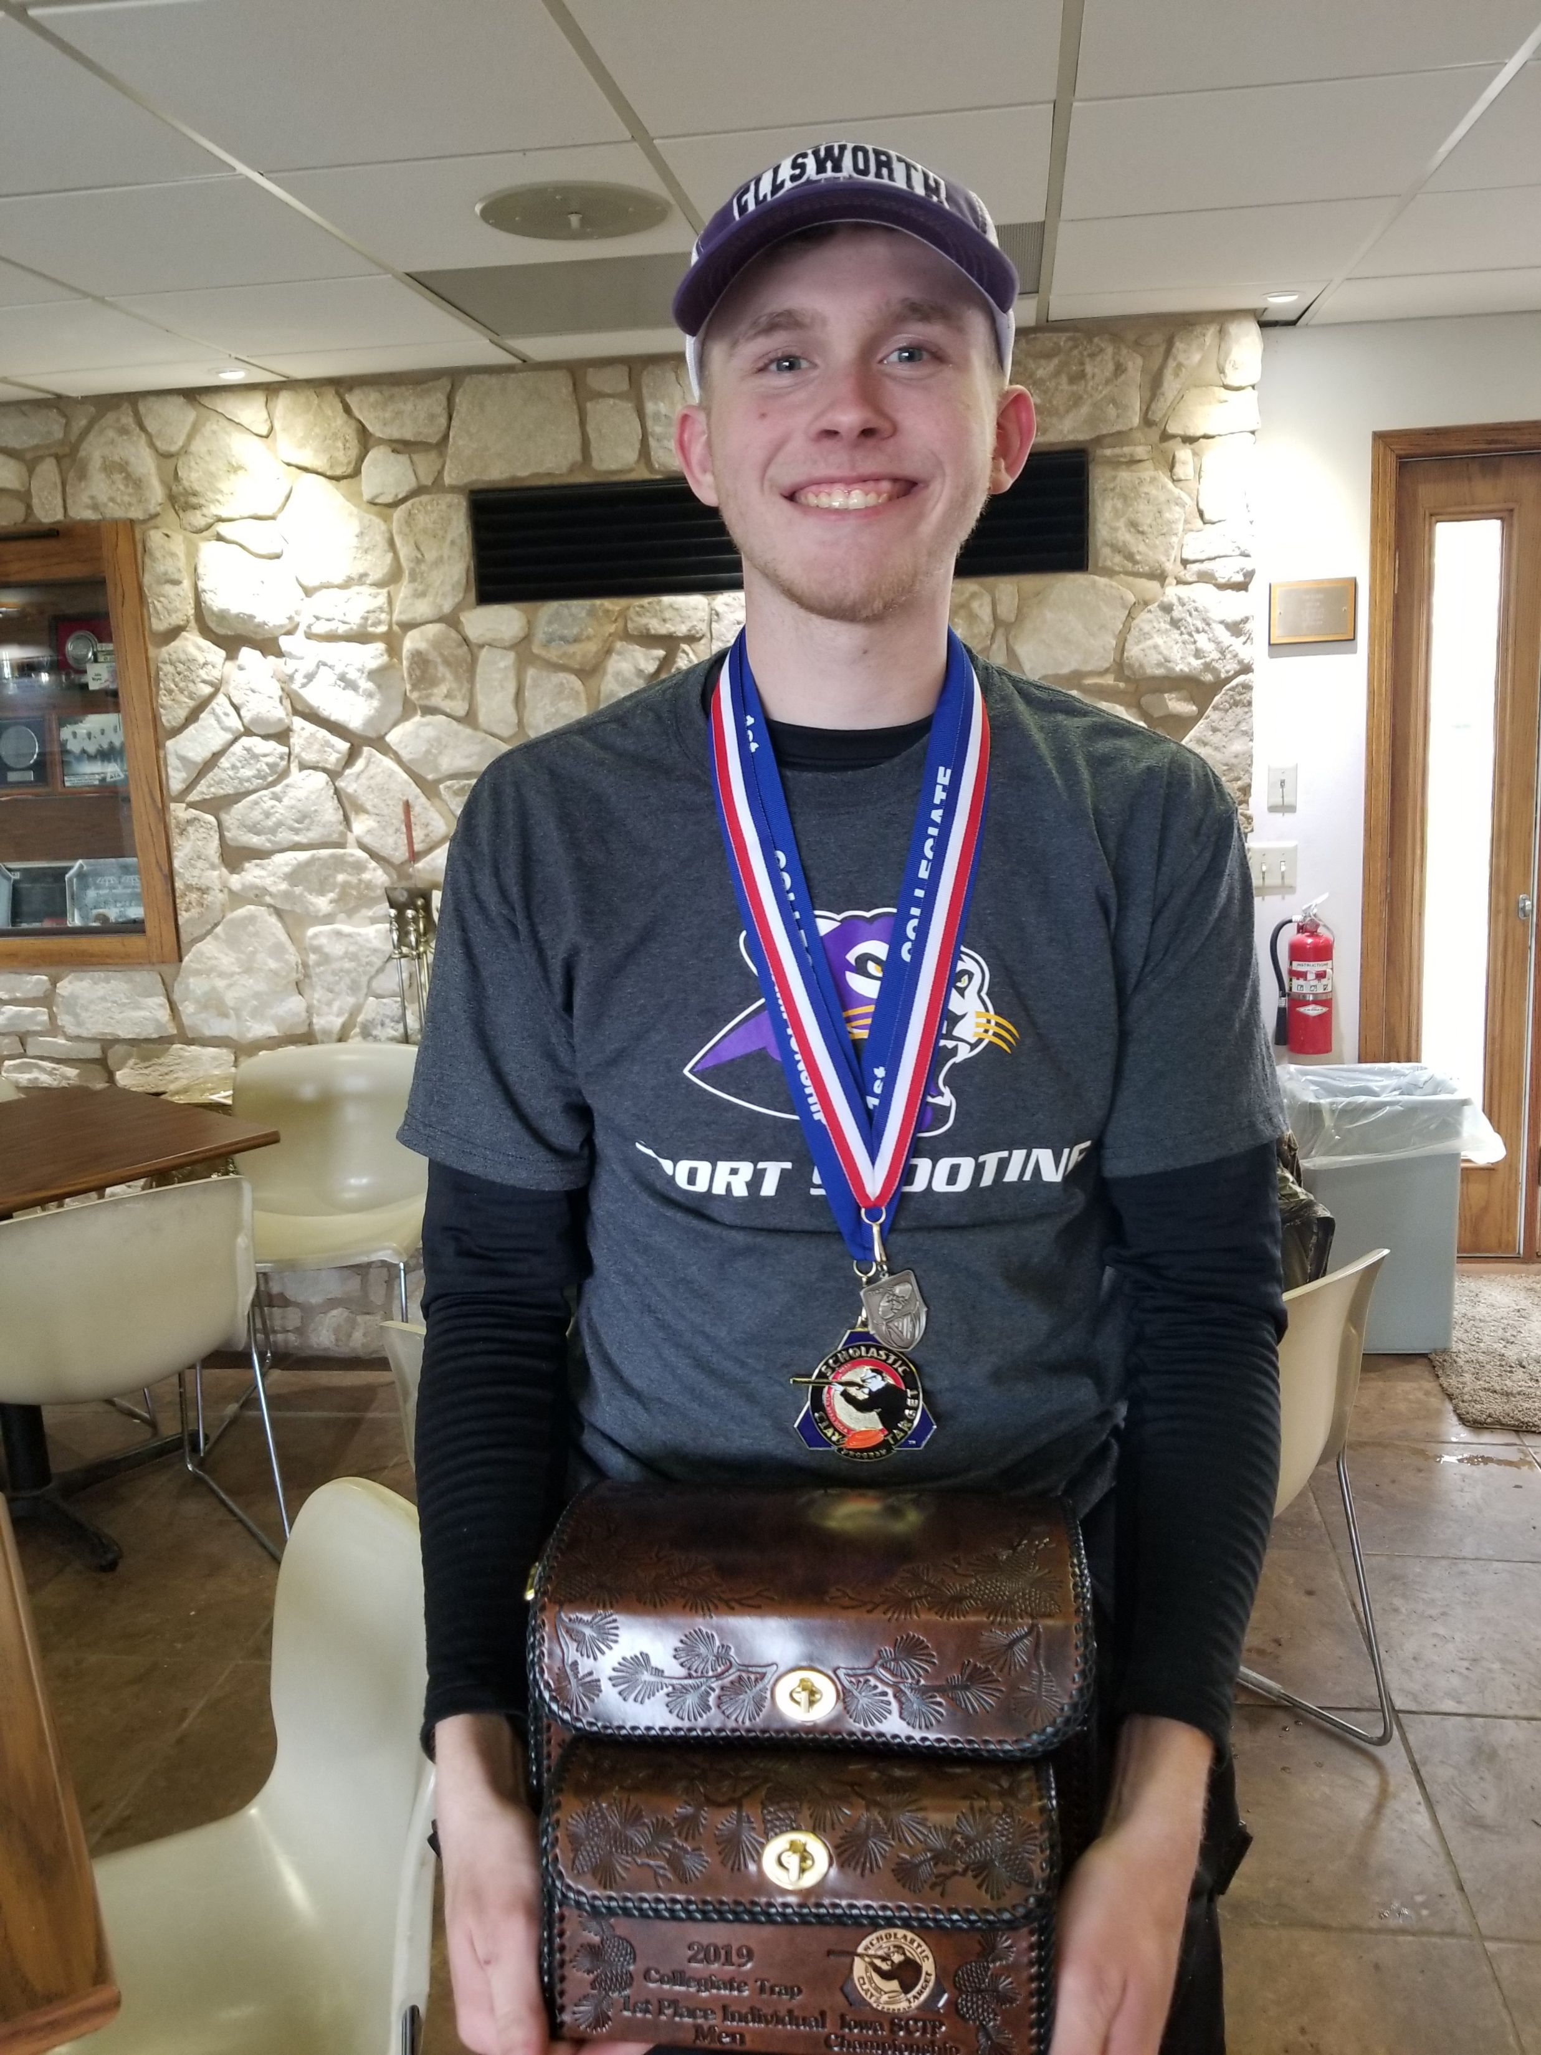
ECC Panther Sports Shooting
State Championship

